Slide 1


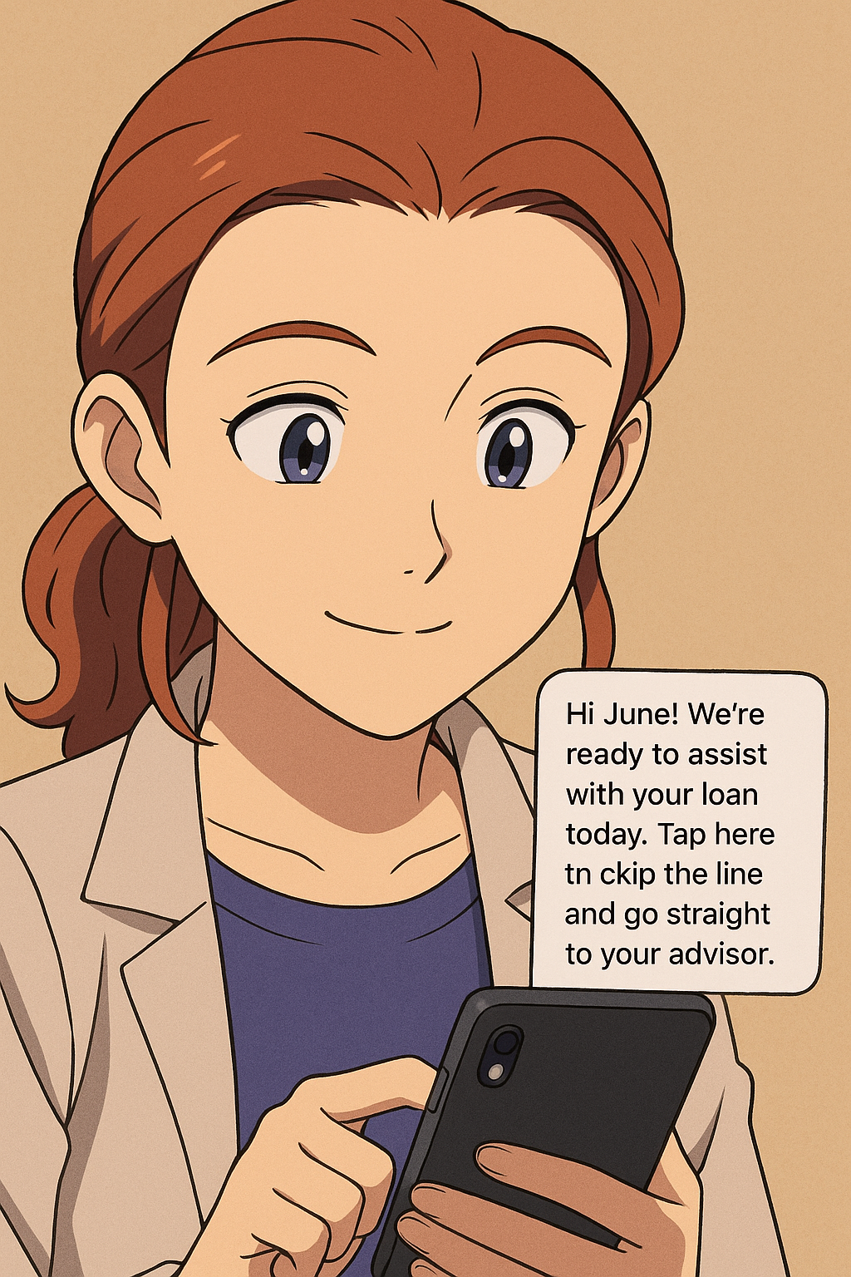


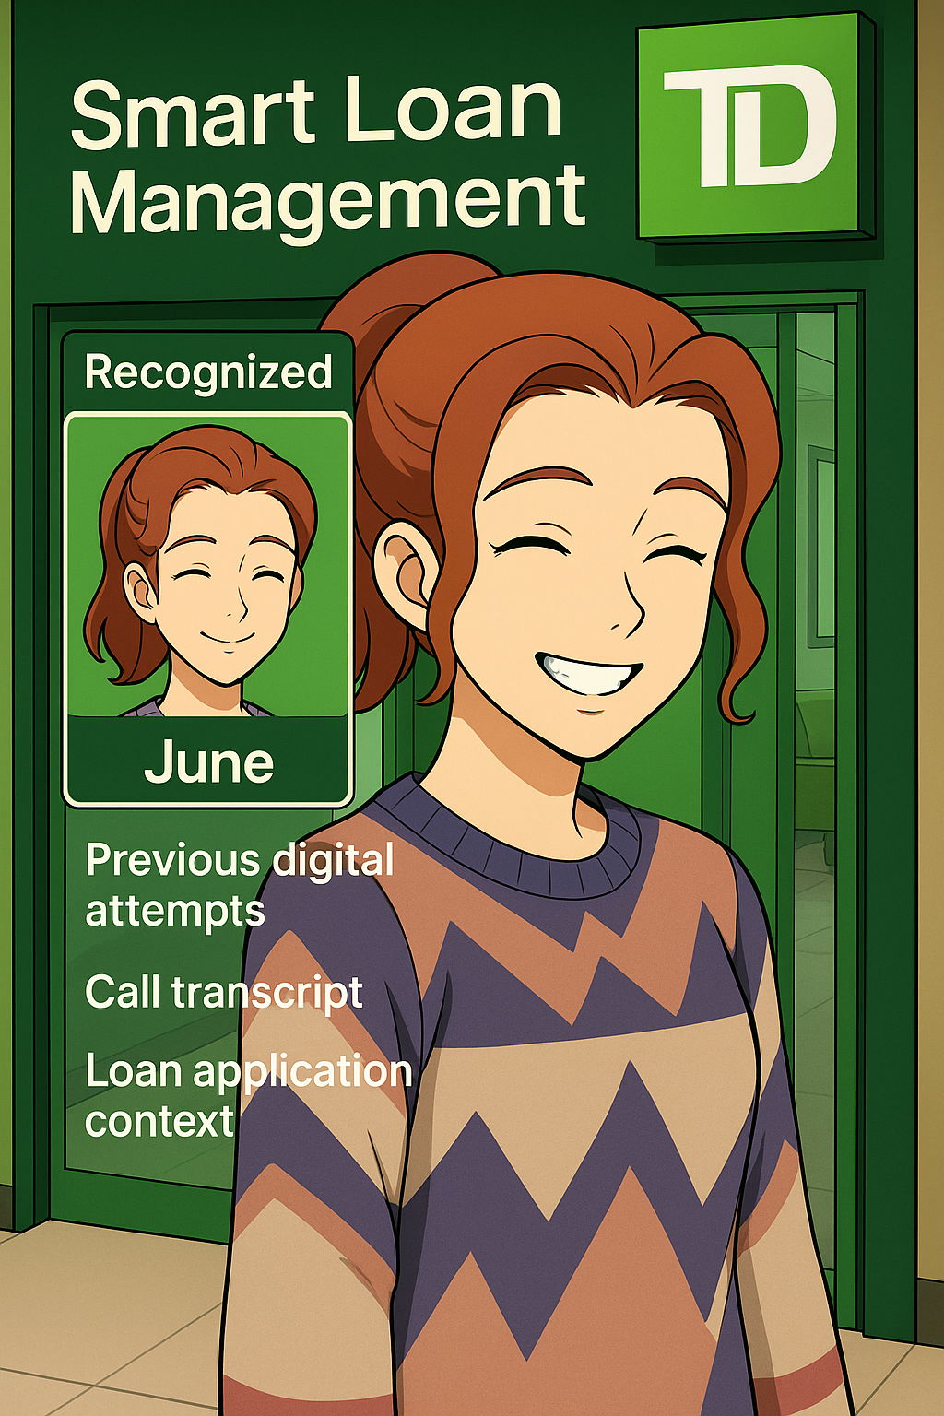

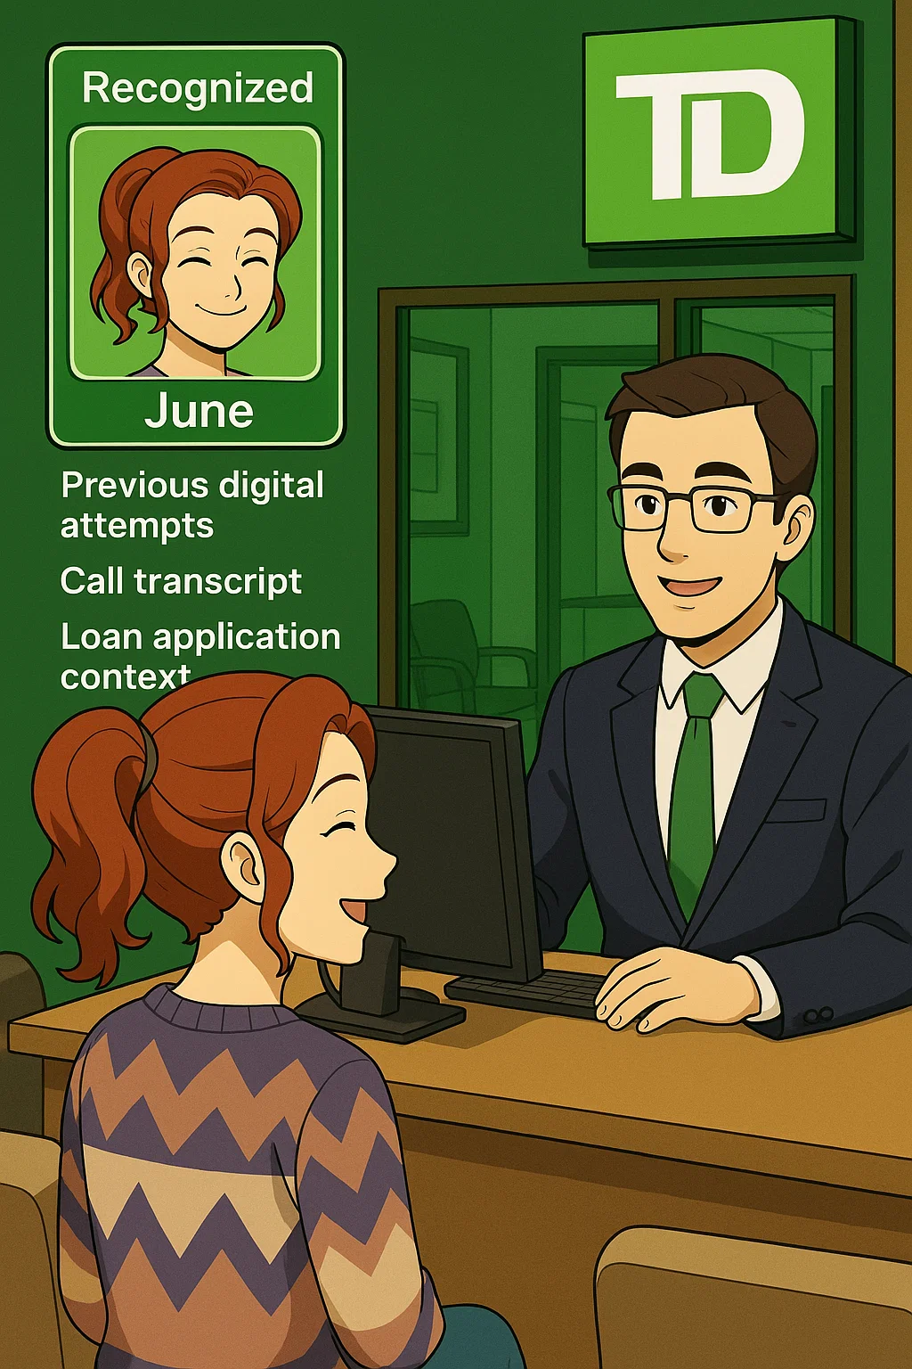


ChimeIn | Loan Help Follow - up
Meet June - June is a Millennial entrepreneur running a boutique design studio. She prefers doing things herself online, but when she ran into trouble applying for a personal loan, she called support. Her call was routed to the right team, but she opted to finish the process in person
1
3
 | https://sora.chatgpt.com/g/gen_01 jvwrf811f4btq74ds0rnqmt0 |  | June resumes her loan journey in branch without starting over Her Digital Readiness Score increases after a guided hybrid experience The advisor completes the loan application faster using preloaded context Branch efficiency improves with reduced intake time and fewer escalations June’s satisfaction increases, knowing her digital and human experiences are connected + Data & Analytics
June enters the Branch…
She authenticates instantly via mobile, skipping the front desk.
4
The advisor is prepared to either continue digitally or complete the application together.
2
June arrives at the branch and is instantly recognized through the MCP framework. Her previous digital attempts, call transcript, and loan application context are surfaced in real time, preloaded by the AI rules engine to ensure a personalized, seamless handoff.
5
It’s like they picked up the conversation where I left off online
June, experiences a connected, low-friction day.
Notes:
June started applying for a loan online but stopped halfway. When she walks into the branch, the Model Context Protocol (MCP) automatically recognizes her and pulls up her previous activity — including digital attempts, call history, and loan details.
The AI business rules engine uses that context to trigger a smart, personalized handoff:
June is greeted instantly on her phone and skips the front desk.
The advisor sees her preloaded file and continues the conversation right where she left off — no repetition needed.
June completes her loan application quickly, with less friction. She feels understood, supported, and is more likely to use digital tools in the future.

